Slide 1
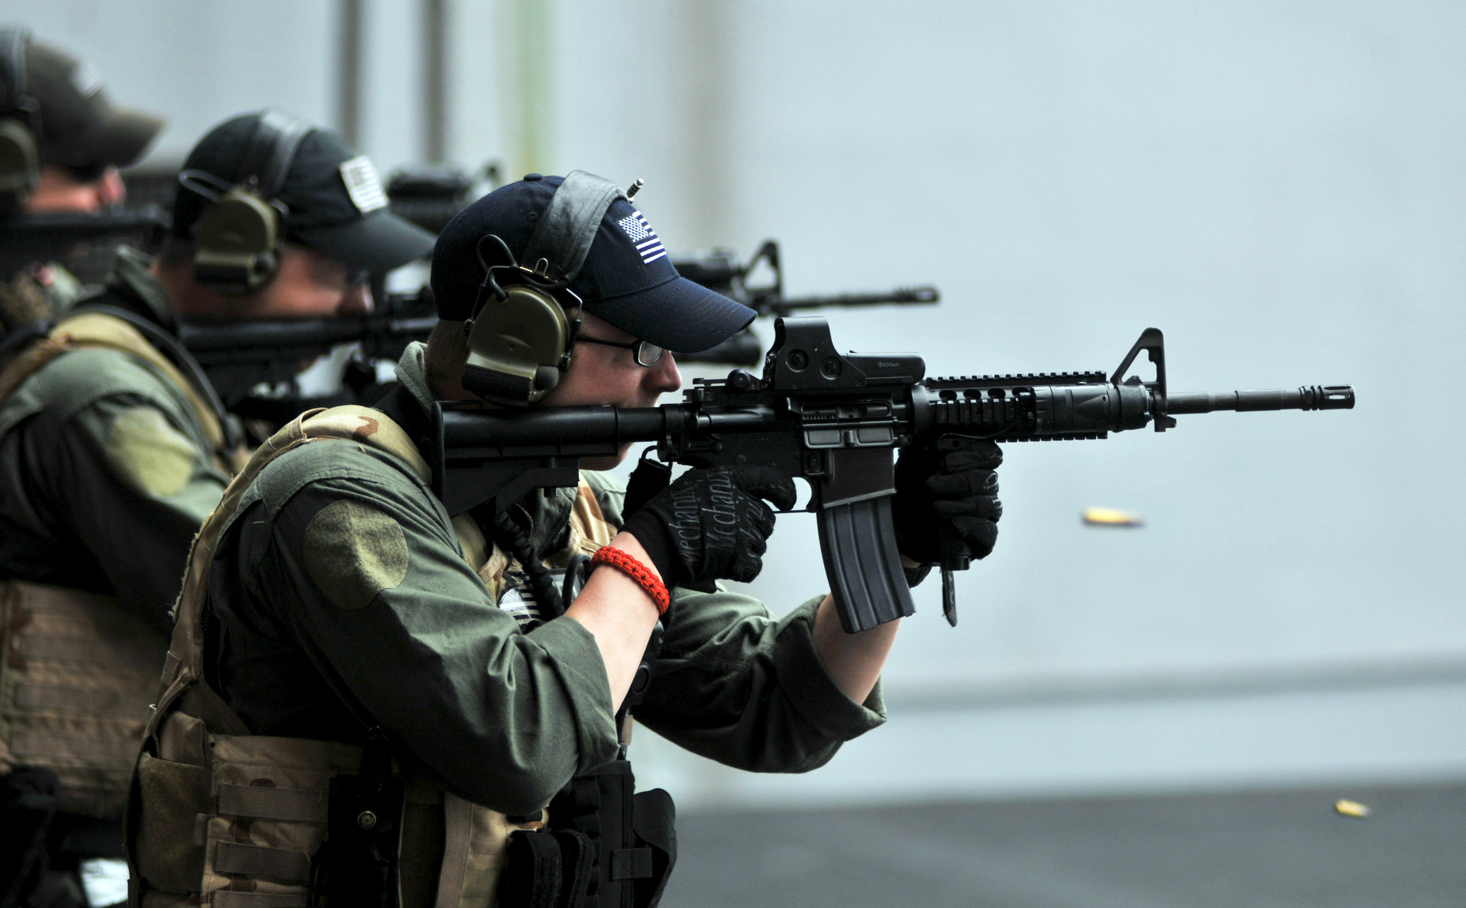
Weapon Inventory
Database
Grup 4

Slide 2



Holla
Rafiq Amalul Widodo
Kurnia Dhita Madani
Reza Madani

Slide 3
Weapon Inventory Database
Weapon inventory database will help Goverment, LEO (Law Enforcement Organization), Military. To update & to input new information about civillian or military personal weapon that they have, it will help surveillance on weapon that they use also with their detail information.

Slide 4


Slide 5
Project Detail
Tables
Quaries
Form
Report
License ID
User ID
Weapon
User Detailed Information Quary
Weapon Quary
Input New License
Input New User
Input New Weapon
Main Menu
User Detailed Information Quary
Weapon Detailed Information

Slide 6
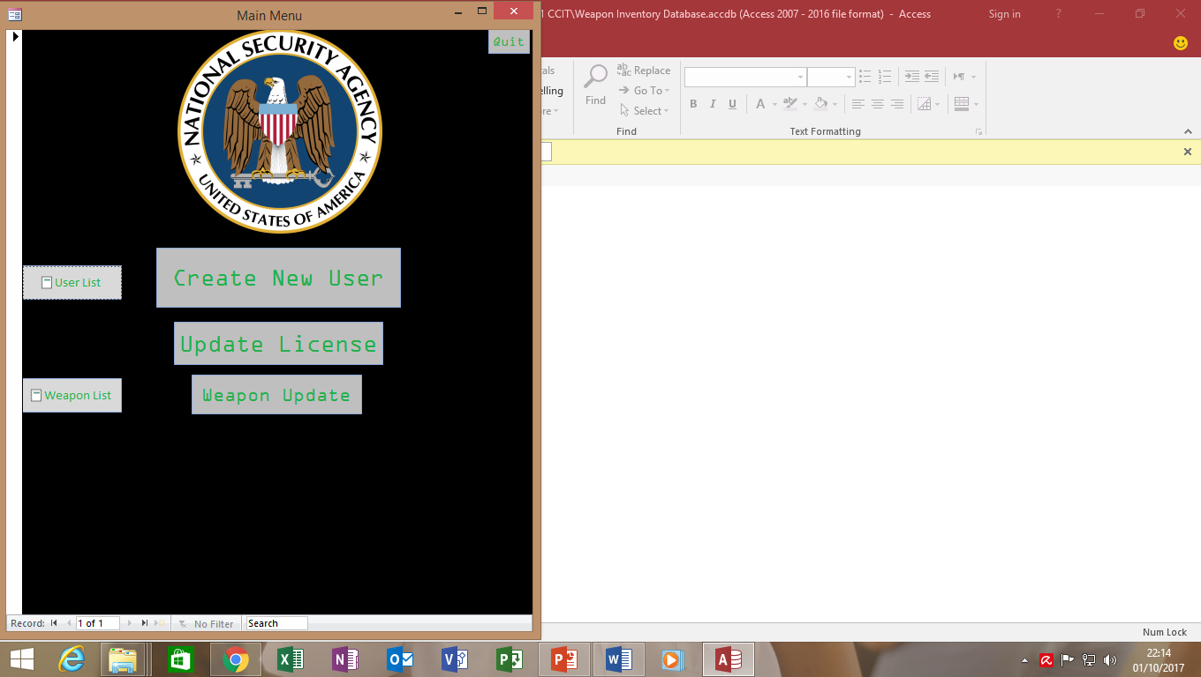
Quit Access
Main Menu
Open Report User Detailed Information Query
Open Form Input New User
Input License
Input New Weapon
Weapon Detailed Info Query

Slide 7

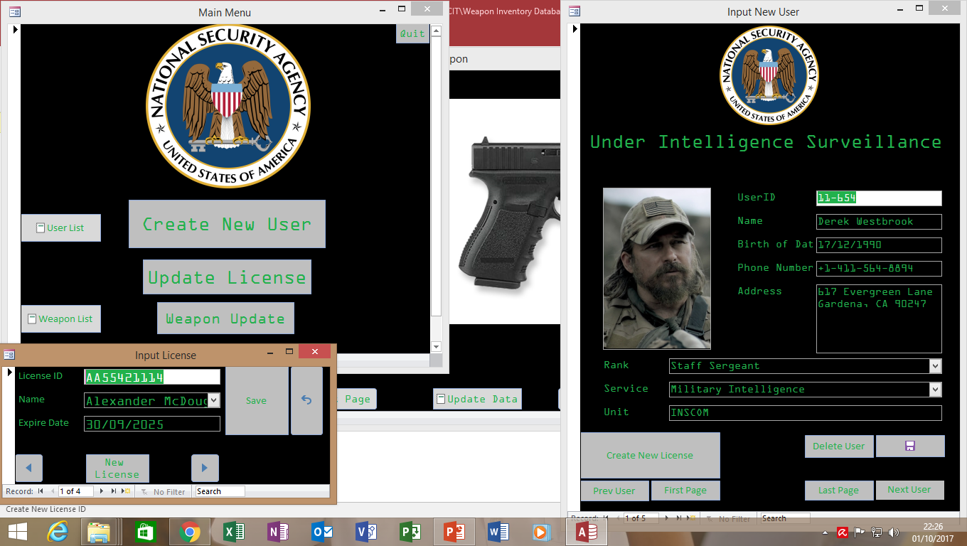
Full Version
Interactive Menu
Form Menu will help client to use database more easily
More Interactive Interface.

Slide 8
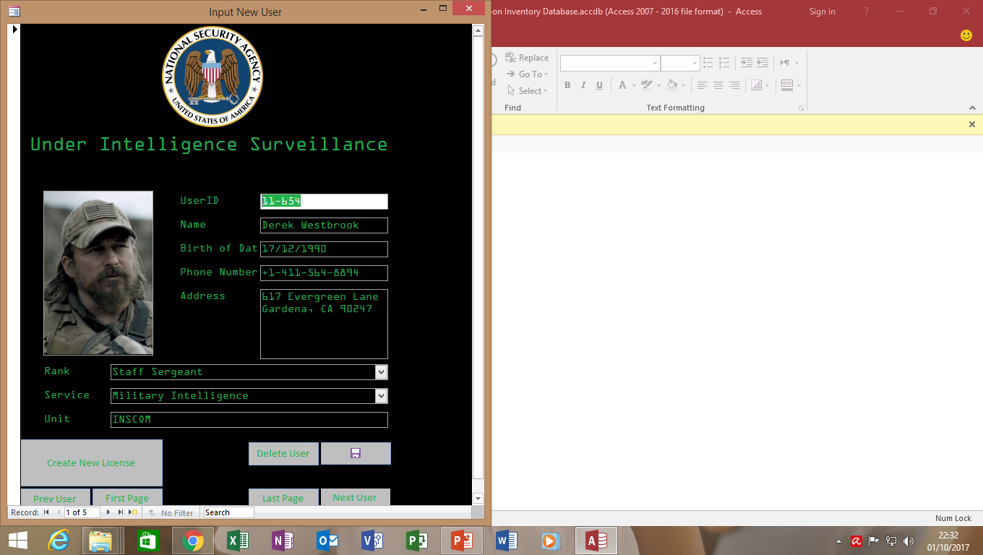
Input New User Form
You can input user information here don’t forget to add photo.

Slide 9
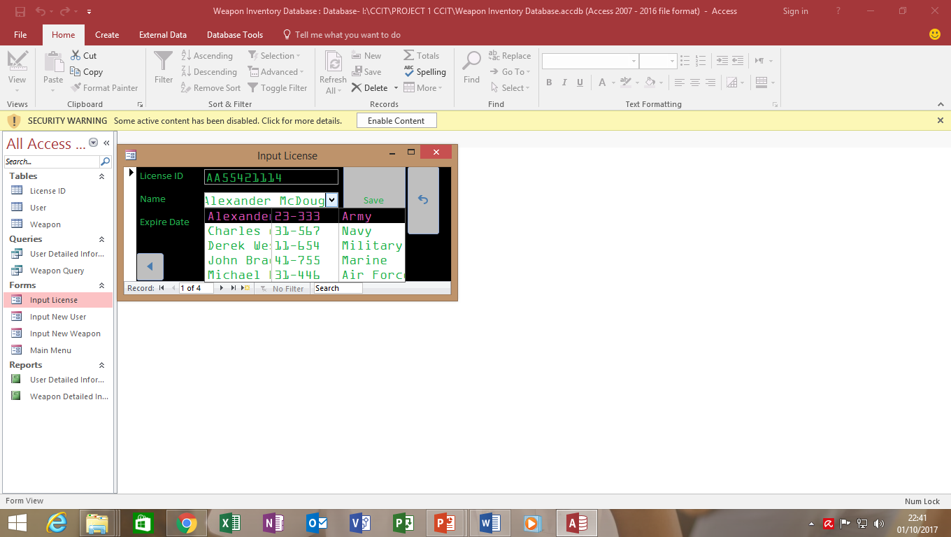
Input New License
You can input new or update license here don’t and you can choose the user from combo box.

Slide 10
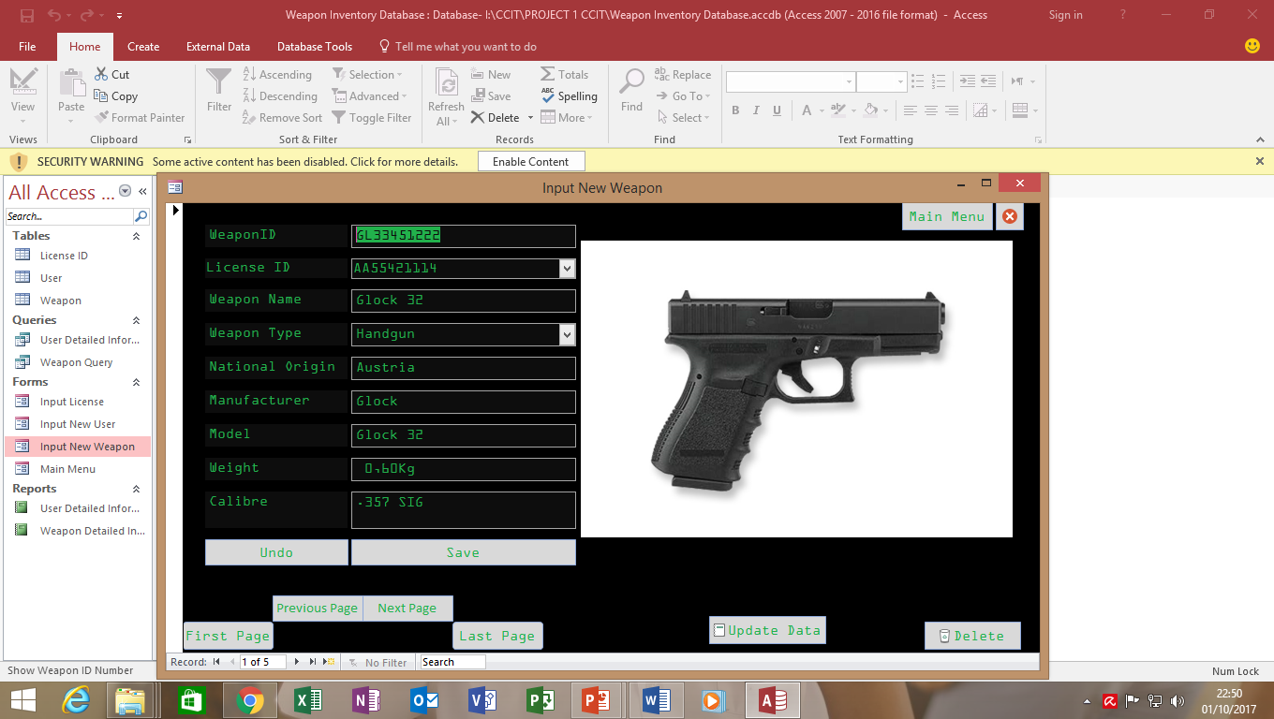
Input New User Form
You can input weapon information, you can choose weapon type from lookup menu here don’t forget to add photo. You must add License ID from combo box.

Slide 11
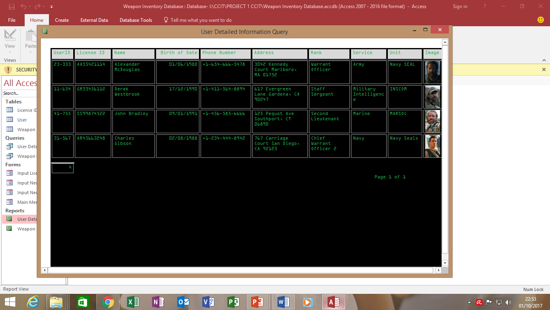
The Result of The User Information That Has Been Entered.

Slide 12
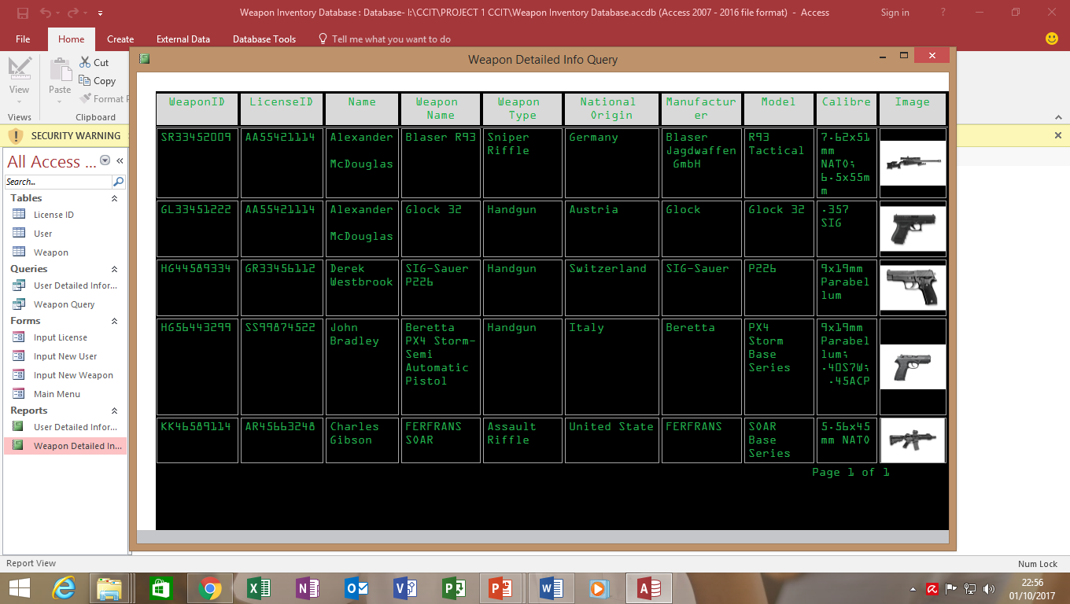
The Result of The Weapon Information That Has Been Entered.

Slide 13
Thank You

